Slide 1


Web Development with HTML & CSS
ORaCle Academy
©2020

Slide 2
Notice!
Content
Introduction
Tools of the trade
Opening a .HTML file
Basics of HTML
What is HTML?
Basic structure of a HTML page
Doctype
Elements
Comments
Character Entities
Styles
This book was written and editted from practical steps and partly from other educative books purposely for tutoring sake.
It's advisable to see every slide as a continuation of the previous.
Not for sale!

Slide 3

Introduction
“Any fool can write code that a computer can understand. Good programmers write code that humans can understand.” – Martin Fowler
Welcome to the world of Web Development. I am so glad and honoured that you joined this course. Before we embark on this learning journey together, let us first define what is CSS.
CSS stands for Cascading Stylesheet and is used for the styling and design of a website. It is one of the many languages a web programmer uses to create a website. Other web languages include HTML, Javascript and PHP, just to name a few.
HTML is concerned with the content and structure of a website. As a website’s existence is meaningless without content, knowing HTML is essential for anyone interested in web programming. This material will first start with an introduction to HTML, covering some of the essential basics you need to know about HTML. While this coverage is by no means comprehensive, it should be enough for you to perform most of the HTML tasks necessary.

Slide 4
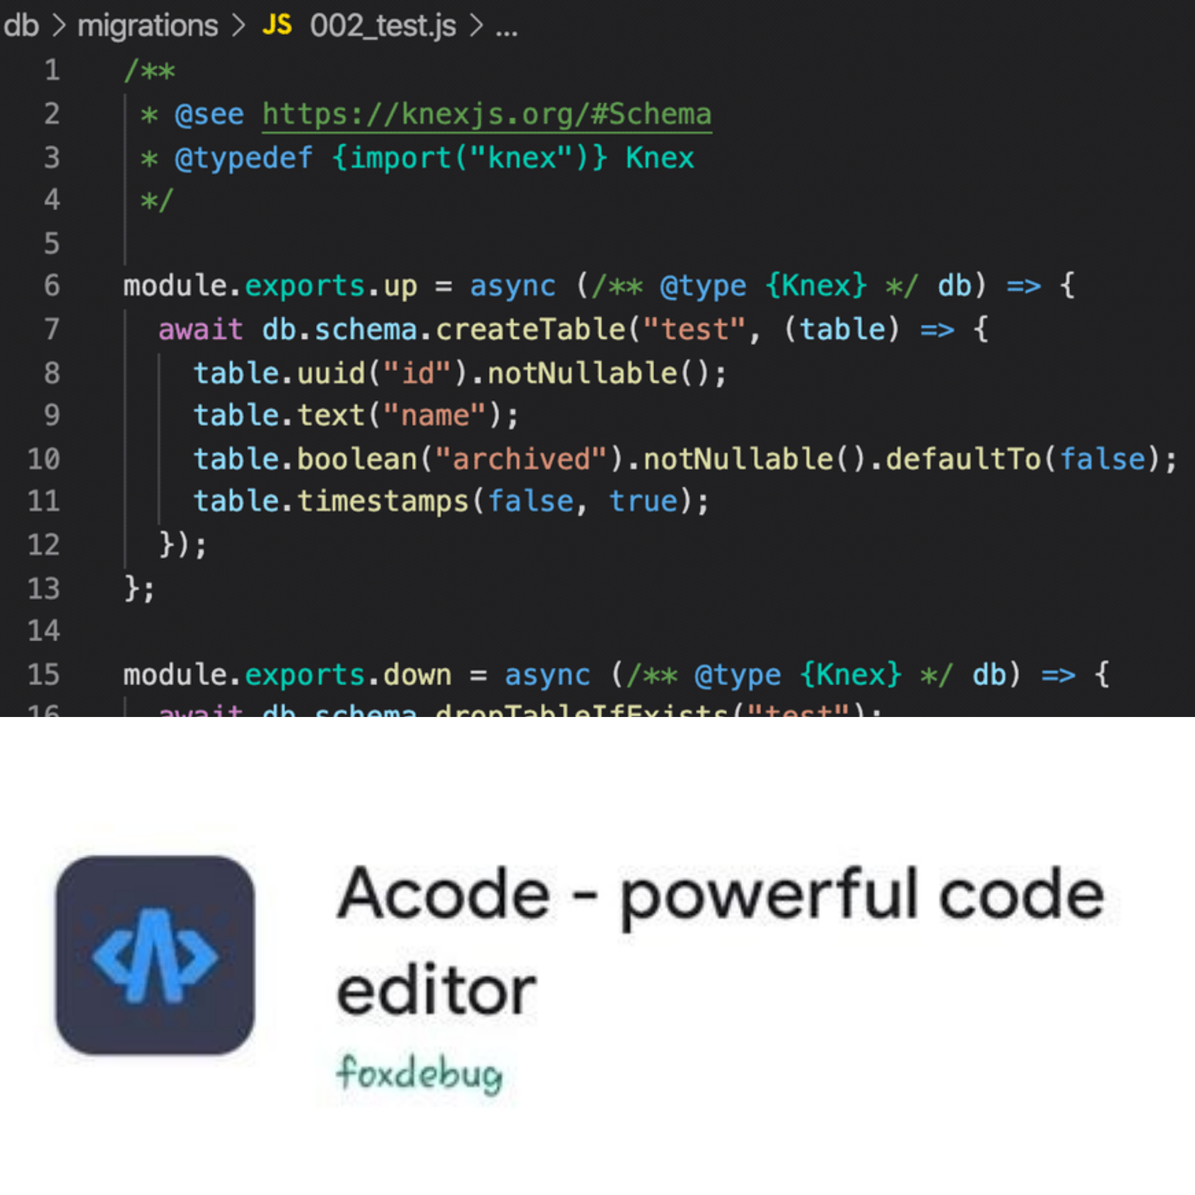
Tools of the trade
Before we start coding our HTML and CSS pages, let us first look at some of the recommended tools for doing web programming.
At the most basic level, you only need a web browser (e.g. Internet Explorer, Chrome, Safari, Firefox) and a text editor (e.g. Notepad) to start coding websites. However, unless you belong to the school of thought that real programmers shouldn’t use any programming aid, I strongly encourage you to use some of the free tools available online to make your coding life easier.
One of the most recommended tool is an advanced text editor that offers syntax highlighting. Syntax highlighting means the editor will display text in different colors depending on the purpose of the text. For instance, the editor may use red color for keywords, blue for comments and green for variables. This simple feature will make your code much easier to read and debug. If you are on your Laptop or PC, I advice you use VS code but if you're on your Smartphone, I advice you use Acode. Both are free to use.

Slide 5

Opening a .HTML File
An .HTML file can be opened in two ways. One way is to open it in a web browser by double clicking on the file. This is for viewing the page. Another way is to open it in a text-editor for editing. To do that, first launch your text-editor and then open the file from within the editor.
When working with HTML files, I suggest you open the file in your browser and text-editor concurrently and arrange the two windows so that they are side-by-side (For PC) or open it in Acode and in your browser also (For Smartphones). That way, you can edit the code on your editor, save it, and then move over to your browser, refresh the page and immediately check the effects of the changes you made to the code.

Slide 6

Basics of HTML
Now that we’ve covered a basic introduction to web programming, let’s start learning some actual HTML code. In the next slides to come, we’ll be covering the essentials of HTML. If you are familiar with HTML, then this is probably not for you.
For those of you who are new to HTML, let’s get started.

Slide 7
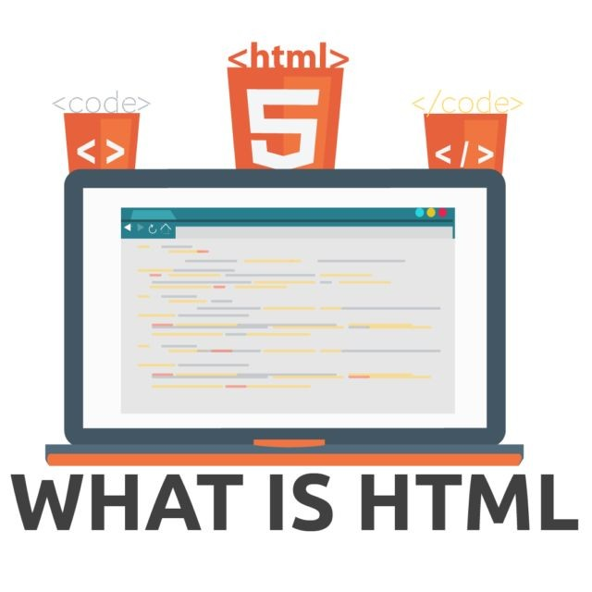
What is HTML?
HTML stands for Hypertext Markup Language and is a language used by web programmers to add content to a web page. A markup language is simply a language for annotating a document to explain what different sections of the text are and how they should be presented. For instance, we can use HTML to specify whether the content should be presented as a list or in table form. The current HTML version is HTML5.
The nicest thing about HTML is that the source code of a web page is free for all to view. This makes it easy for us to learn HTML by studying the codes of other web pages. To view the source code of a web page on Windows, simply right-click anywhere on the page and select “View Source” (or something similar, such as “View Page Source”, depending on the browser you use). If you are on Mac, click on “View” in the menu bar, select “Developer” and then select “View Source”.
Most of the source code that you view will look very complicated, especially if you have no prior knowledge in HTML. Don’t worry about that. Soon, you’ll be able to write such ‘complicated’ codes yourself.
To get a better understanding of how HTML5 works, let’s start by examining the basic structure of a HTML document.

Slide 8

Basic Structure of a HTML Page
An example of a basic HTML document is shown below. I’ve added numbers beside each line of the code for easy reference. These numbers are not part of the actual code.
1 <!doctype html>
2 <html>
3 <head>
4 <title>My First HTML Page</title>
5 </head>
6 <body>
7 <p>This is just text</p>
8 <img src=”someimage.jpg” alt=”Just some image”>
9 </body>
10 </html>
As you can see from the code above, HTML uses a lot of angle brackets with a single word enclosed inside, such as <head> and <body>. These are known as tags and each tag has a specific meaning in HTML.

Slide 9
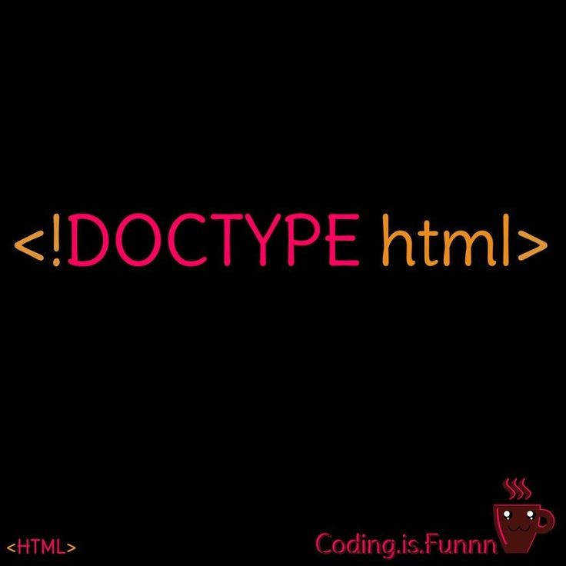
Doctype
On line 1, the <!doctype html> tag tells the browser that this document uses HTML5. If you check the source of older web pages, you may see something like <!DOCTYPE HTML PUBLIC "-//W3C//DTD HTML 4.01//EN" "http://www.w3.org/TR/html4/strict.dtd">. This means they are using other versions of HTML, such as HTML4.01 in this case.

Slide 10
Elements
Start and end tags
On line 2, the <html> tag tells the browser that the actual HTML code starts here. Most tags in HTML have a corresponding end tag. The end tag for the <html> tag is found on line 10. It has an additional forward slash (/) before the word html.
Note that not all tags in HTML have end tags. For instance, the <img> tag, which is used to add images to our webpage does not have an end tag. Generally, there is a need for an end tag when we need to let the browser know where the effect of the tag should end. For instance, if we want to bold some text in HTML, we can write
This text is <strong>important</strong>, but this text is not.
We’ll get
This text is important, but this text is not.
The <strong> tag and the </strong> tag tells the browser where the bold effect should start and where it should end. In contrast, there is no need to tell the browser where an inserted image should end. Hence, the <img> tag does not require an end tag.
Elements in HTML are groups of matching tags. There are two basic elements in HTML: The Head Element and the Body Element.
The tags that can be found in bother tags will be individually explain in coming slides but before then it is important to look at “start and end tags” for ease when dealing with upcoming tags.

Slide 11
The Head Element
On line 3, we have the start of the head element.
In the broadest sense, a HTML document is made up of two main elements, the head and the body elements.
The head element provides general information about the document, including its meta data, title and links to additional resources. It starts with the <head> tag on line 3 and ends with the </head> tag on line 5. Within the <head>...</head> tags, we enclose other tags that provide all these behind-the-scene information about the document.
In our example, we only included information about the title in our head element. The title element (on line 4) shows the title that the browser should display on its title bar or on the page's tab. In this case, the text “My First HTML Page” will be displayed. We’ll cover more tags that are used within the head element in a later section.
The Body Element
Line 6 is where the body element starts. Contents within the <body>...</body> tags will be displayed on the webpage. In our example, the text “This is just text” and the image “someimage.jpg” will be displayed.
There are a lot of other tags that we can use inside the <body>...</body> tags, such as the <img> tag for adding images, the <table> tag for displaying tables and the <ul> tag for adding a list. We’ll cover these tags in detail

Slide 12
Elements Within the Head Element
Now that we understand how HTML works, let us look at the head element in detail.
As mentioned above, the head element provides general information about the document, such as its metadata, title and links to external resources. Let’s look at some of the tags within the head element.
<meta>
The <meta> tag is included within the <head>…</head> tags and is used to provide additional information about the website to the browser, search engines or other web services. These information will not be displayed on the page itself. The <meta> tag does not have an end tag.
One common use of the <meta> tag is to provide keywords for search engines. An example is:
<meta name="description" content=”This is my first Website. It teaches you how to use HTML and CSS">
Another common use of the <meta> tag is to use it to specify how the browser should control the page zoom level and dimensions. This is done using the name=viewport attribute. For instance, you can write
<meta name="viewport" content="width=300, initial-scale=1">
width=300 sets the width of the viewport to be equals to 300 pixels. One pixel, px, is equal to one dot on the computer screen.
When you set the viewport to 300px and you have an image that is, say, 500 pixels wide, you will only see a portion of the image as the image’s width is larger than the width of the viewport. To see the rest of the image, you have to scroll the page. In contrast, if you set the viewport to 500px, the entire image will be shown without any scrolling needed. If you set the viewport to 1000px, the entire image will be shown too, but it’ll be smaller and occupy only half the width of the screen.
initial-scale=1 sets the initial zoom level (1x in this case) of the page when it is first loaded by the browser.

Slide 13
Elements Within the Head Element [Cont'd]
<title>...</title>
The <title> tag is used for defining the title that the browser should display on its title bar or on the page's tab.
<style>...</style>
The <style> tag is used to add internal CSS code to our HTML document. We’ll learn how to do that in Chapter 3.
Example:
<style type=”text/css”>
body {
…
}
</style>
<link>
The <link> tag is used to link to an external resource, most commonly used to link to an external CSS stylesheet. It does not require an end tag.
Example:
<link rel="stylesheet" type="text/css" href="mystyle.css">
The rel and type attributes simply tell the browser that you are linking to a CSS stylesheet. You do not need to modify them. The only attribute that you need to modify is the href attribute. This attribute is used to state the path of the CSS file.
How to write paths to external files
The path of any external file always starts from the current folder of the HTML document. Suppose we have five folders: ‘User’, ‘Documents’, ‘MyWebsite’, ‘MyCSS’ and ‘MoreCSS’ with the following structure:
User > Documents > MyWebsite > MyCSS > MoreCSS
That is, the ‘User’ folder contains the ‘Documents’ folder, which in turn contains the ‘MyWebsite’ folder. Within the ‘MyWesbite’ folder, we have the ‘MyCSS’ folder, which contains the ‘MoreCSS’ folder.
If you are working on a HTML file in ‘MyWebsite’ and you want to link to ‘mystyle.css’ in the SAME folder, you simply write href = “mystyle.css”.
However, if ‘mystyle.css’ is in the ‘MyCSS’ folder (one level down), you have to write href = “MyCSS/mystyle.css”. If it is in ‘MoreCSS’ (two levels down), you have to write href = “MyCSS/MoreCSS/mystyle.css”
If ‘mystyle.css’ is in the ‘Documents’ folder (one level up), you have to use ../ to move one level up. You write href = “../mystyle.css”. If it is in the ‘User’ folder, you have to move two levels up. You write href = “../../mystyle.css”.

Slide 14
Elements Within the Body Element
Now that we’ve covered the elements within the head element, let us move on to the body element.
Elements for Adding Content to the Page
First, let us discuss some commonly used elements for adding content to our webpage. These tags are enclosed within the <body>...</body> tags.
<p>... </p>
This is the paragraph tag and is used to add text to a page. Any content within the two tags will be displayed as a paragraph. By default, most browsers will add a line before and after a paragraph.
Example:
<p>This is a paragraph</p>
<img>
This <img> tag is for adding images to your webpage. It requires you to provide some additional information like the location of the image, its height and width etc. Commonly used attributes of the <img> tag include:
src:
Stands for “source” and is used to state the path of the image. The src attribute must be provided.
height:
For specifying the desired display height of the image
width:
For specifying the desired display width of the image
alt:
Stands for “alternate” and is used to specify the text to display if the image fails to load.
Example:
<img src=”images/myImage.jpg” height=”100px” width=”100px” alt=”My Image”>
This will insert the image “myImage.jpg” onto the webpage. The image will be scaled to a size of 100px by 100px. If the image fails to load, the text “My Image” will be displayed instead.
<a>...</a>
The <a> tag is used to insert a hyperlink. The most important attribute for the <a> tag is href which is used to specify the URL of the page the link goes to.
Example:
<a href=”http://www.google.com”>Click here to go to Google</a>
Output:
Click here to go to Google
Clicking on the link will bring you to the Google website.

Slide 15
Elements Within the Body Element [Cont'd]
<h1>...</h1> to <h6>...</h6>
The <h1> to <h6> tags are heading tags and are used to define HTML headings. <h1> is the most important heading and <h6> is the least important. Text within heading tags are normally displayed with a larger font size on the browser, with h1 having the largest font size and h6 having the smallest.
Example:
<h1>This is the most important heading.</h1>
<h2>This is the second most important heading.</h2>
Output:
This is the most important heading.
This is the second most important heading.
<ol>...</ol> and <li>...</li>
The <ol> tag stands for ordered list and is used to create a list with numbers or alphabets as list markers.
Example:
<ol>
<li>Chocolate</li>
<li>Strawberry</li>
<li>Vanilla</li>
</ol>
Output:
1. Chocolate
2. Strawberry
3. Vanilla
<ul>...</ul> and <li>...</li>
The <ul> tag stands for unordered list and is similar to the <ol> tag. However, instead of using numbers or alphabets as list markers, it uses shapes (such as a dot, or a hollow circle).
<table>...</table>, <tr>...</tr>, <th>...<th>, <td>...</td>
The <table> tag is used to create a table. <tr> stands for “Table Row”, <th> stands for “Table Header” and <td> stands for “Table Data”. Tables are created row by row in HTML.

Slide 16
Elements Within the Body Element [Cont'd]
Example (numbers are not part of the code):
1 <table>
2 <tr>
3 <th>Name</th>
4 <th>Gender</th>
5 </tr>
6 <tr>
7 <td>Abigail</td>
8 <td>F</td>
9 </tr>
10 <tr>
11 <td>Benny</td>
12 <td>M</td>
13 </tr>
14 </table>
This code will give you a table with 3 rows and 2 columns. Line 2 to 5 defines the first row of the table, which is a header row as the <th> tag is used. Line 6 to 9 defines the second row and lines 10 to 13 defines the third.
Elements Used in Conjunction with CSS
There are two special HTML elements that do not have any inherent meaning in HTML. They are mainly used in conjunction with CSS to style a specific section of the webpage. These two elements are div and span.
<div>...</div>
<div> stands for ‘division’ and is used to define a division or a section in a HTML document. The <div> tag is normally used in conjunction with CSS to format the contents within the <div>...</div> tags.
For instance, if we write:
<div>
This is some division in the HTML document.
<ol>
<li>Chocolate</li>
<li>Strawberry</li>
<li>Vanilla</li>
</ol>
</div>
we can use CSS to format everything inside the div tags (i.e. both the text and the ordered list). We’ll learn how to do that with CSS.

Slide 17
Elements Within the Body Element [Cont'd]
<span>...</span>
The <span> tag is similar to the <div> tag. The main difference is that <div> is a block element, while <span> is an inline element.
A block element is one that starts and ends with a new line break. In contrast, an inline element does not start or end with a line break. For instance, if we write
This is a <div>block element</div>, while this is an <span>inline</span> element.
we’ll get
This is a
block element
, while this is an inline element.
As the phrase ‘block element’ is tagged with the <div> tag, it starts and ends on a new line. On the other hand, the word ‘inline’ is an inline element and does not start or end on a new line. Generally, we tend to use <div> to wrap sections of a document, while <span> is used to wrap small portions of text, images,
Elements For Adding Javascript Code to Website
<script>...</script>
The <script> tag is used to add internal Javascript code to our HTML document or to link to an external script. Javascript is a scripting language that adds interactivity to our website..
Example (to add internal JS code):
<script>
document.getElementById("para1").innerHTML = "Hello JavaScript!";
</script>
Example (to link to an external JS script):
<script type=”text/javascript” src="myscripts.js"></script>
Elements For Formatting Text
<strong>...</strong>
The <strong> tag is used to define important text. Most browsers will bold the text.
Example:
The examination will be held on <strong>12 Jan at 2pm</strong>. Latecomers will not be allowed into the hall.
Output:
The examination will be held on 12 Jan at 2pm. Latecomers will not be allowed into the hall.

Slide 18
Elements Within the Body Element [Cont'd]
<em>...</em>
The <em> tag is used to define emphasized text. Most browsers will display the text in italics form.
Example:
The examination will be held on 12 Jan at 2pm. Latecomers <em>will not</em> be allowed into the hall.
Output:
The examination will be held on 12 Jan at 2pm. Latecomers will not be allowed into the hall.
Elements for Defining Sections of a Webpage
HTML also comes with a few tags for defining sections of a webpage. These tags do not do much, their purpose is simply to indicate to the browser and developer which section the content they enclose belongs to.
<header>...</header>
The header element defines the top section of a webpage and normally consists of the logo/banner of the website. Do not confuse the header element with the head element. The head element defines all the behind the scene stuff and is not displayed on the page. The header element on the other hand defines content that is to be displayed at the top of the website.
<nav>...</nav>
nav stands for navigation and is used to define a set of navigation links (i.e. menu).
<main>...</main>
The main element is used to define the main section of a page.
<footer>...</footer>
The footer element is the counterpart of the header element and is used to define the footer of the web page (i.e. the bottom section). The header and footer elements are similar to the ‘header’ and ‘footer’ sections of a MS Word document. For Word documents, we normally use the footer to display the page number. On a website, we normally use it to include additional links and additional information (such as contact information and copyright information).
Note that all the four elements above are to be included in the <body>...</body>. Their purpose is mainly to further segment the <body> element into different sections. The code in the next slide shows how these elements are used.

Slide 19
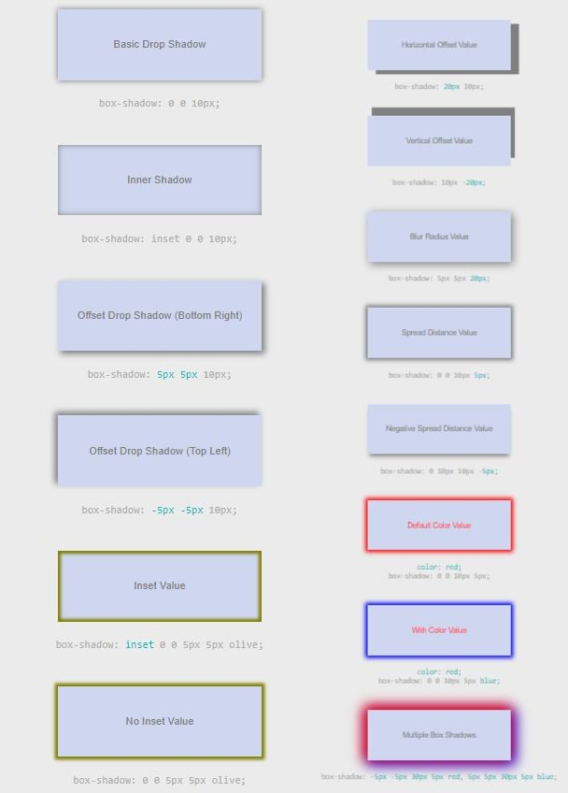
<!doctype html>
<html>
<head><title>An example</titlte></head>
<body>
<header>
<!-- Insert Banner or Logo Here -->
</header>
<nav>
<!-- Insert Navigation Links Here -->
</nav>
<main>
<!-- Insert Main Content Here -->
</main>
<footer>
<!-- Insert Footer Here -->
</footer>
</body>
</html>

Slide 20

Comments
Notice that in the previous example, we used a lot of the <!-- and --> symbols? These are known as comments.
Most of the time when we program, we need to add comments to our code to make it easier to read and understand. This is extremely important if we are working with other programmers or if we need to edit the source code at a later date. Comments are not displayed in the browser, they are merely added to explain our code.
To add comments to a HTML documents, we use the <!--... --> tag.
Example:
<!--This is a comment. It will not be displayed in the browser.-->

Slide 21

Character Entities
Some characters have predefined meanings in HTML and are reserved for that specific use. For instance, the less than sign (<) is used to start all tags. What happens if we need to display the text 5<12 on our webpage?
To do that, we need to use character entities. Character entities always start with an ampersand
sign (&) and end with a semi-colon (;). There are two ways to display the less than sign. We can either write &lt; or &#60;. The first is known as the entity name while the latter is known as the entity number. An entity name is easier to remember (lt stands for less than) but some browsers do not support all entity names. On the other hand, entity numbers are harder to remember but the support is better.
Commonly used character entities include
Less than sign (<)
&lt; or &#60;
Greater than sign (>)
&gt; or &#62;
Ampersand sign (&)
&amp; or &#38;
For instance, if you want to display 5<12 on your website, you write it as 5&lt;12 in your HTML code.
<div style="text-decoration:underline; color:blue;">Some text</div>
Out of the three methods, linking is the preferred method. Linking separates the HTML content from the styling rules and makes it easier to maintain our codes. It is also extremely useful when we need to apply the same CSS rules to multiple web pages.
Embedded CSS, on the other hand, is commonly used when the rules only apply to one web page.

Slide 22
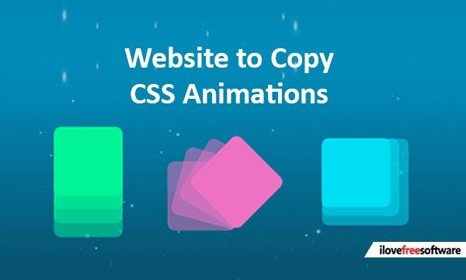
Styles
Now that we’ve covered quite a bit of HTML, let’s move on to CSS. CSS stands for Cascading Stylesheet and as the name suggests, CSS is all about styling and making your website look gorgeous.
The latest version of CSS is CSS3. Unlike previous versions of CSS (namely CSS1 and CSS2.1), CSS3 splits the language into different modules so that each module can be developed separately at a different pace. In the next book, each module adds new features or extends the capabilities of features previously defined in CSS 2.1. Essentially, CSS3 is simply an extension of CSS2.1.
This book has covered the core properties of HTML.
In the next book, you'll learn the core properties of CSS of CSS 2.1 and CSS3 .Once you master the core properties, you will have no problems moving on to more advanced properties that are newly added in CSS3. These advanced properties allow for more fanciful styling of your website, such as adding transitions and animations.

Slide 23

References and credits
References
“Learn CSS in one day and learn it well” by Jamie Chan
http://www.learncodingfast.com/css
W3schools.org
Credits
Unsplash and Pinterest [Photos]
Bukola Olapade [Compilation]
ORaCle Academy [Support]

Slide 24
ORaCle Academy
Like us on Facebook
[m.facebook.com/OracleAcad]
Follow us on Twitter
[@academy_oracle]
To stay connected and know more about our upcoming tutorials and programmes.
Peace ☮

